Slide 1

UNIVERSITY INSTITUTE OF ENGINEERING
DEPARTMENT OF AIT - CSE
Bachelor of Engineering (CSE)
Statistics for Data Science(23CSH-233)
Faculty: Prof. (Dr.) Madan Lal Saini(E13485)
Lecture -3.6
Minimum Variance Estimation
DISCOVER . LEARN . EMPOWER

Slide 2
Chapter | Course Objectives
3 | This course helps students to understand and apply the basic concepts of estimation, regression, weak law of large numbers, and central limit theorem.
Chapter | Course Outcomes
3. | Students will be able to Analyze the real-world problem via a probabilistic approach.

Slide 3
Contents
Minimum Variance Estimation.
Most efficient estimator
Minimum Variance Estimation
Invariance property

Slide 4
Most efficient estimator
4

Slide 5
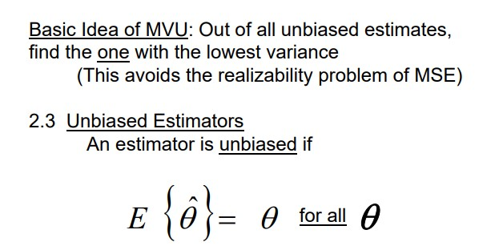
Minimum Variance Unbiased Estimator
5

Slide 6
Minimum Variance Unbiased Estimator
6

Slide 7
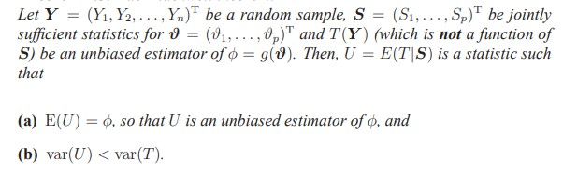
Approaches to find MVUE
Cramer-Rao Lower Bound (CRLB)
Rao-Blackwell-Lechman-Scheffe Theorem
Rao-Blackwell theorem

Slide 8

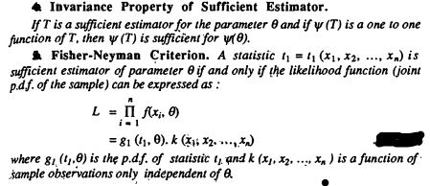
Invariance property

Slide 9
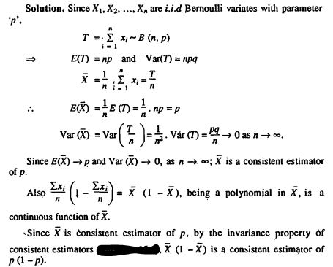

Slide 10
References
Online Video Link-
https://www.youtube.com/watch?v=_hzcxijfPk8&ab_channel=Dr.HarishGarg
https://www.youtube.com/watch?v=Q7cogjehUt0&ab_channel=DaneMcGuckian
Textbooks / Reference Books
Text Books
T1: Advanced Engineering Mathematics by R.K. Jain and S. R. K. Iyengar, Narosa Publications.
T2: Probability and Statistics for Engineers and Scientists by Sheldon M. Ross, Academic Press.
Reference Books
R1: Fundamental of mathematical Statistics by SC Gupta and VK Kapoor, S. Chand Publication.
R2: Probability by Lipschitz, Schaum outline series, Mc.Graw hill Publication.

Slide 11
THANK YOU

